Slide 1
UNIT – III: Cloud Storage Structure
The Evolution of Storage Technology, Storage Models, File Systems, and Databases, Distributed File Systems: The Precursors, General Parallel File System, Google File System, Apache Hadoop, Locks and Chubby: A Locking Service, Transaction Processing and NoSQL Databases, BigTable, Megastore.

Slide 2
INTRODUCTION
The volume of data generated by human activities is growing about 40% per year; 90% of the data in the world has been gathered in the last two years.
Following are several data sources which cause the massive amounts of data stored on a cloud and cloud data storage supports the demand of data to various applications
A variety of sensors feed streams of data to cloud applications
Big Data growth can be viewed as a three dimensional phenomenon:
(i) implies an increased volume of data.
(ii) requires increased processing speed to process more data and produce more results and
(iii) involves a diversity of data sources and data types.
Billions of Internet-connected mobile and stationary devices access data stored on computer clouds.

Slide 3
INTRODUCTION
Annual global IP traffic passed the zettabyte, 1000 exabytes [EB] threshold by the end of 2016, and reached 2.3 ZB per year by 2020
Storage and processing: Data analytics uses the very large volumes of data collected by many organizations to optimize their businesses.
Applications in many areas of science, including genomics, structural biology, high energy physics, astronomy, meteorology, and the study of the environment, carry out complex analysis of data sets often of the order of terabytes
A cloud is a large-scale distributed system with a very large number of components which must work in parallel. The management of the large collection of storage systems poses significant challenges.

Slide 4
NOTE: Conclusion from the above points, Computer memory is limited in storage.
So that, Cloud Data Storage is required.
CLOUD DATA STORAGE: Effective data replication and storage management strategies are critical to the computations performed on the cloud. Following parameters are supported by cloud data storage:
reduce in the access time
support multimedia access with the timing requirements of data streaming and content delivery.
Data replication allows concurrent access to data from multiple processors and decreases the chances of data loss.
Maintaining consistency among multiple copies of data records increases- the data management software complexity and could negatively affect the storage system performance if data is frequently updated

Slide 5
THE EVOLUTION OF STORAGE TECHNOLOGIES
As the volume of data stored per year is constantly increasing. So that, storage technology has evolved at an accelerated pace.
1986: 2.6 EB; equivalent to less than one 730 MB CD-ROM of data per computer user.
• 1993: 15.8 EB; equivalent to four CD-ROMs per user.
• 2000: 54.5 EB; equivalent to 12 CD-ROMs per user.
• 2007: 295 EB; equivalent to almost 61 CD-ROMs per user
2003 study shows that during the 1980–2003 period the storage density of hard disk drives (HDD) has increased by four orders of magnitude from about 0.01 Gb/in2 to about 100 Gb/in2
The density of DRAM (Dynamic Random Access Memory) increased from about 1 Gb/in2 in 1990 to 100 Gb/in2 in 2003.
The capacity of NAND flash-based devices faster than DRAM capacity growth and the cost per gigabyte has significantly declined.
Storage devices are using solid state technologies such as Phase-Change Memory. Solid state memories are based on the charge of the electron, other fundamental property of an electron, its spin, is used to store information.
A new field known as spintronics, an acronym for spin transport electronics, storage media based on antiferromagnetic materials with much shorter switching times.
Solid state drives (SSDs) can support hundreds of thousands IOPS (I/O operations per second).

Slide 6
Advantage: The density of storage devices has increased and the cost has decreased dramatically, the access time has improved only slightly.
Disadvantage: The performance of I/O subsystems has not kept pace with the performance of processors.
This performance gap affects multimedia, scientific, engineering, and other modern applications which process increasingly large volumes of data.
Note: the cost of storage management is the dominant element of the total cost of a storage system- This effect favors the centralized storage strategy can automate some of the storage management functions such as replication and backup and thus, reduce substantially the storage management cost( if data storage is distributed system and leads to more storage management cost.)

Slide 7
Disk technologies: Hard disk drives are secondary storage media for general-purpose computers.
An HDD is a non-volatile random-access data storage device consisting of one or more rotating platters coated with magnetic material.
Magnetic heads mounted on a moving actuator arm read and write data to the surface of the platters.
HDD has a spindle motor that spins the disks and an actuator that positions the read/write head assembly across the spinning disks.
The rotation speed of platters in HDDs ranges from 4 200 rpm for energy-efficient portable devices, to 15 000 rpm for high-performance servers.
HDDs for desktop computers and laptops are 3.5-inch and 2.5-inch, respectively.

Slide 8
HDDs are characterized by capacity and performance. The capacity is measured in Megabytes (MB), Terabytes (TB), or Gigabytes (GB).
The average access time is the HDD performance indicator. Access time = the seek time+ the time for the arm to reach to the track + the time to locate the record on a track.
Disadvantage: The physical space available on the rack limits this number.
Increasing the disk space of a data center is costly.
Solid-State Disks are persistent storage devices using integrated circuit assemblies as memory and replace the traditional disks. SSDs do not have moving parts and more resistant to physical shock, run silently, have lower access time, and lower latency than HDDs

Slide 9
Lower-priced SSDs use triple-level or multi-level cell (MLC) flash memory, slower and less reliable than single-level cell (SLC) flash memory.
The MLC to SLC ratios of persistence, sequential write, sequential read, and price are 1 : 10, 1 : 3, 1 : 1, and 1 : 1.3, respectively. Most SSDs use MLC NAND-based flash memory, a non-volatile memory that retains data when power is lost.
Most SSD manufacturers use non-volatile NAND due to lower cost compared with DRAM and the ability to retain the data without a constant power supply
Solid state hybrid disks (SSHDs) combine the features of SSDs and HDDs, they include a large HDD and an SSD cache to improve performance of frequently accessed data

Slide 10
STORAGE MODELS, FILE SYSTEMS AND DATABASES
Storage models: A storage model describes the layout of a data structure in physical storage
A data model captures the most important logical aspects of a data structure in a database.
The physical storage can be a local disk, a removable media, or storage accessible via the network
Commonly used Storage Models : cell storage and journal storage.
Two highly desirable properties of any storage model: Read/write coherence and before-or-after atomicity

Slide 11
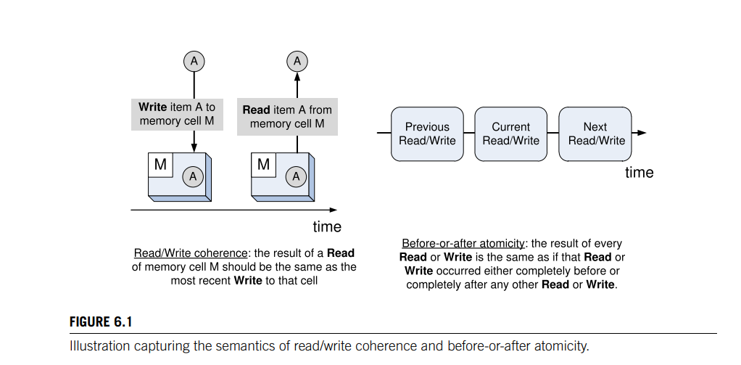
Cell storage: The storage consists of cells of the same size and that each object fits exactly in one cell. This model reflects the primary memory is organized as an array of memory cells and a secondary storage device-disk is organized in sectors or blocks (read and written as a unit).

Slide 12
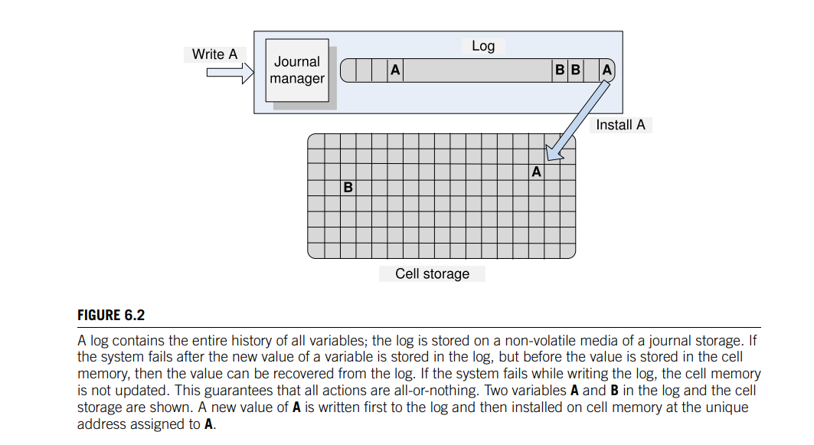
Journal storage: This storage stores composite objects such as records consisting of multiple fields. Journal storage consists of a manager and a cell storage where the entire history of a variable is maintained, rather than just the current value.
The user does not have direct access to the cell storage instead it can request the journal manager to: (i) start a new action (ii) read the value of a cell (iii) write the value of a cell (iv) commit an action and (v) abort an action.
The journal manager translates user requests to commands sent to the cell storage: (i) read a cell; (ii) write a cell; (iii) allocate a cell; and (iv) deallocate a cell

Slide 13
A log contains the history of all variables in a cell storage.
The information about the updates of each data item forms a record appended at the end of the log.
The cell storage can be reconstructed using the log which can be easily accessed through a pointer to the last record.
The log is always kept on non-volatile storage, e.g., disk with larger cell storage resides in it. The log kept in memory for real-time access or using a write-through cache.

Slide 14
FILE SYSTEMS:
A file system consists of a collection of directories and each directory provides information about a set of files. High-performance systems can choose among three classes of file systems: Network File Systems (NFS), Storage Area Networks (SAN), and Parallel File Systems (PFS)
Network file systems are very popular but do not scale well and have reliability problems. An NFS server could be a single point of failure.
Storage Area Networks: Advances in the networking technology allow the separation of the storage systems from the servers and connected by a SAN. SANs offer flexibility and allow cloud servers to deal with non-disruptive changes in the storage configuration.
The storage in a SAN can be pooled and then allocated based on the needs of the servers. Pooling requires additional software and hardware support and represents another advantage of a centralized storage system. A SAN-based implementation of a file system can be expensive, as each node must have a Fiber Channel adapter to connect to the network.
Parallel file systems: are scalable and capable of distributing files across a large number of nodes, and provide a global naming space. In a parallel file system several I/O nodes serve data to all computational nodes and include also a metadata server which contains information about the data stored in the I/O nodes. The interconnection network of a parallel file system could be a SAN

Slide 15
DATABASES AND DATABASE MANAGEMENT SYSTEMS:
Cloud applications do not interact directly with the file systems but through an application layer which manages a database. A database is a collection of logically-related records.
The software that controls the access to the database is called a Data Base Management System (DBMS). The main functions of a DBMS are: enforce data integrity, manage data access and concurrency control and support recovery after a failure.
A DBMS supports a query language, as programming language used to develop database applications. A DBMS is an interface for several database models such as navigational model, the relational model, the object-oriented model, and the NoSQL model.
Cloud databases: Cloud applications are data-intensive. Limitations of the existing cloud storage infrastructure demands for database management systems to support rapid application development. Cloud applications require low latency, scalability, high availability and demand a consistent view of the data. These requirements cannot be satisfied simultaneously by existing database models.

Slide 16
for example, relational databases are easy to use for application development, but do not scale well.
As its name implies, the NoSQL model does not support SQL as a query language and may not guarantee the ACID, Atomicity, Consistency, Isolation, and Durability properties of traditional databases. It usually guarantees an eventual consistency for transactions limited to a single data item.
Many cloud applications support online transaction processing and have to guarantee the correctness of the transactions. Transactions consist of multiple actions

Slide 17
for example, the transfer of funds from one account to another requires withdrawing funds from one account and crediting it to another.
The system may fail during or after each one of the actions and steps to ensure correctness must be taken.
Correctness of a transaction means that the result should be guaranteed to be the same as if the actions were applied one after another regardless of the order.
Other wise, for example, banking transactions must be processed in the order they are issued, the so-called external time consistency.
To guarantee correctness, a transaction processing system supports all-or-nothing atomicity.

Slide 18
DISTRIBUTED FILE SYSTEMS: THE PRECURSORS
The main concerns in the design of these systems(NFS,UFS,AFS,SPRITE,RFS) are scalability, performance, and security,
NFS was the firstly used distributed file system. The development of this application based on the client-server model supports to share a file system among a number of clients interconnected by a local area network.
A majority of workstations were running under UNIX. Hence, design decisions for the NFS were influenced by the design philosophy of the UNIX File System (UFS).
Then the NFS designers aimed to:
• Provide the same semantics as a local UFS to ensure compatibility with existing applications.
• Facilitate easy integration into existing UFS.
• Ensure that the system will be widely used. Thus, support clients running on different operating systems.
• Accept a modest performance degradation due to remote access over a network with a bandwidth of several Mbps.
UFS has three important characteristics which enabled the extension from local to remote file management

Slide 19
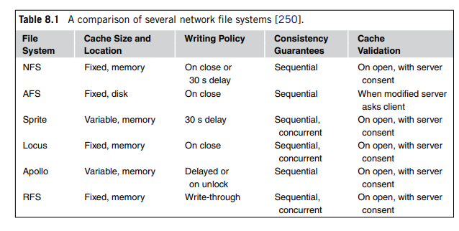
1. The layered design provides the flexibility of the file system through the separation of concerns and minimization of the interaction among the modules needed to implement the system. The vnode layer allows UFS to treat uniformly local and remote file access.
2. The hierarchical design supports file system scalability. It groups the files into special files called directories.
This hierarchical design supports multiple levels of directories and collections of directories and files called file systems.
The hierarchical file structure is reflected by the file naming convention.
3. The metadata represents design philosophy of the file system.

Slide 20
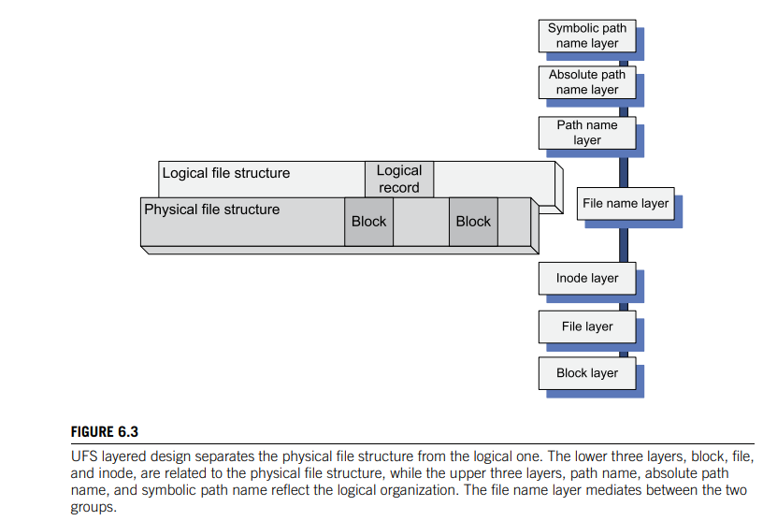
Inodes contain information about individual files and directories and are kept on persistent media together with the data.
Metadata includes the file owner, the access rights, the creation time or the time of the last modification of the file, the file size, as well as information about the structure of the file and the persistent storage device cells where data is stored.

Slide 21
The logical organization of a file reflects the data model and the view of the data from the perspective of the application.
The physical file structure reflects the storage model and describes the manner the file is stored on a given storage media.
The layered design allows UFS to separate the concerns for the physical file structure from the logical one.
A file is a linear array of cells stored on a persistent storage device.
The file pointer identifies a cell used and performs a read or write operation.
This linear array is viewed by an application as a collection of logical records.
The file stored on a physical device viewed as a set of physical records, or blocks, of size dictated by the physical media.

Slide 22
The lower three layers of the UFS hierarchy reflect the physical organization.
The block layer allows the system to locate individual blocks on the physical device.
The file layer reflects the organization of blocks into files.
The inode layer provides the metadata for the objects (files and directories).
The upper three layers reflect the logical organization.
To access a file, a process establish a connection with the file system by opening the file. Then a new entry is added to the file description table and the meta-information is brought in to another control structure, the open file table.
A path specifies the location of a file, or directory, in a file system.
A relative path specifies the file location relative to the current/working directory of the process.
A full path also called an absolute path specifies the location of the file independently of the current directory and relative to the root directory.
A local file is uniquely identified by a file descriptor (fd), generally, an index in the open file table.

Slide 23
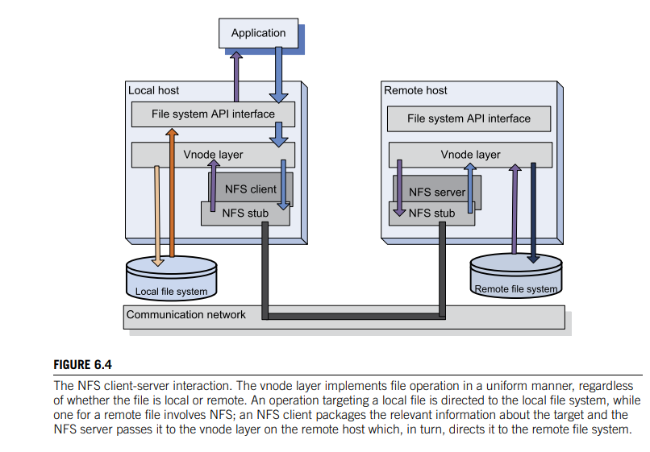

Slide 24
NFS is based on the client-server paradigm.
The client runs on the local host, while the server is at the site of the remote file system.
The client and the server interact by means of Remote Procedure Calls (RPCs), Figure 6.4.
The API interface of the local file system distinguishes file operations on a local file from the ones on a remote file and, in the later case, invokes the RPC client.
The API for a UNIX file system, the calls made by the RPC client in response to API calls issued by a user program for a remote file system, as well as some of the actions carried out by the NFS server in response to an RPC call.
NFS uses a vnode layer to distinguish between operations on local and remote files as shown in Figure 6.4.

Slide 25
A remote file is uniquely identified by a file handle (fh), rather than a file descriptor.
The file handle is a 32-byte internal name, a combination of the file system identification, an inode number, and a generation number.
The file handle allows the system to locate the remote file system and the file on that system; the generation number allows the system to reuse the inode numbers and ensures a correct semantics when multiple clients operate on the same remote file.
While many RPC calls, such as Read, are idempotent to communication failures could sometimes lead to an unexpected behavior. Indeed, if the network fails to deliver the response to a Read RPC, then the call can be repeated without any side effects.

Slide 26
By contrast, when the network fails to deliver the response to the RPC, the second call returns an error code to the user if the call was successful the first time; if the server fails to execute the first call then the second call returns normally.
Note: There is no Close RPC because this action only makes changes to the open file data structure of the process and does not affect the remote file.
The NFS has undergone significant transformations along the years and it has evolved from Version 2, Version 3 and then to Version 4.

Slide 27
Andrew File System: AFS is a distributed file system developed in the late 1980s at Carnegie Mellon University (CMU) in collaboration with IBM.
The designers of the systems envisioned a very large number of workstations interconnected with a relatively small number of servers; This concept bring up the Andrew workstation would connect up to 10 000 workstations.
The set of trusted servers in AFS form a structure called Vice. The workstation OS, 4.2BSD UNIX, intercepts file system calls and forwards them to a user-level process called Venus which caches files from Vice and stores modified copies of files back on the servers they came from.
Reading and writing operations are performed directly on the cached copy of the file and bypass Venus.
Only when a file is opened or closed does Venus communicate with Vice.
The AFS design is on performance, security, and simple management of the file system .
The local disks of a workstations act as persistent cache ensuring scalability and reducing the response time.
The master copy of a file residing on one of the servers is updated only when the file is modified. This strategy reduces the server load and improves the system performance.

Slide 28
The AFS design has improved security. The communications between clients and servers are encrypted and all file operations require secure network connections.
When a user signs in to a workstation the password is used to obtain security tokens from an authentication server. These tokens are then used every time a file operation requires a secure network connection.
AFS uses Access Control Lists (ACLs) to allows control sharing of the data.
An ACL specifies the access rights of an individual user or of a group of users. A set of tools support the management of ACLs.
Files could be accessed from any location and could be moved automatically at the request of system administrators without user’s involvement and inconvenience.
Servers reduces the efforts related to system administration as operations such as backups affect only the servers while workstations can be added, removed, or moved from one location to another without administrative intervention.

Slide 29
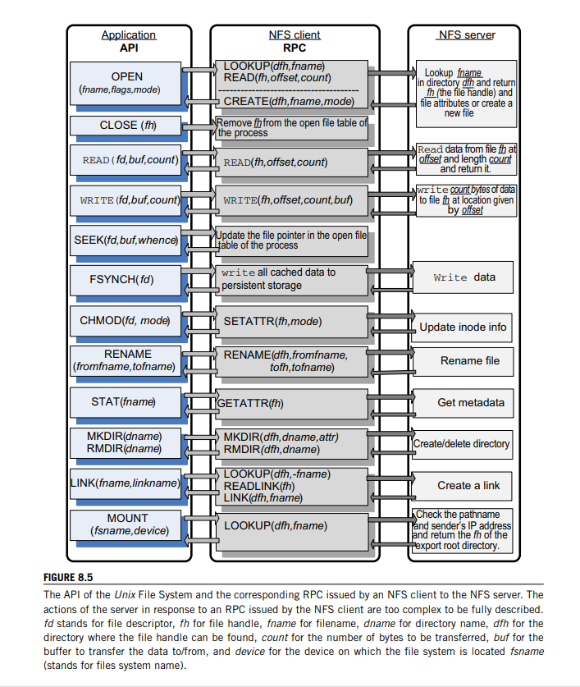

Slide 30
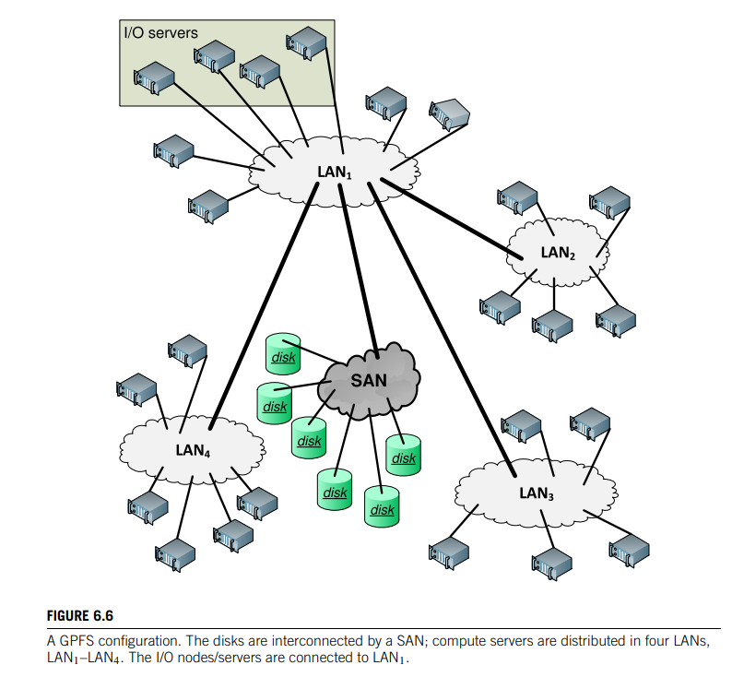
GENERAL PARALLEL FILE SYSTEM

Slide 31
A general parallel file system is a type of storage system designed to store data across multiple networked servers and to facilitate high-performance access through simultaneous, coordinated input/output operations (IOPS) between clients and storage nodes.
IBM General Parallel File System (GPFS) is a high-performance clustered file system software. It can be deployed in shared-disk or shared-nothing distributed parallel modes.

Slide 32
The General Parallel File System (GPFS) [317] was developed at IBM in the early 2000s as a successor to the TigerShark multimedia file system [159].
GPFS is a parallel file system that emulates closely the behavior of a general-purpose POSIX system running on a single system.
GPFS was designed for optimal performance of large clusters; it can support a file system of up to 4 PB consisting of up to 4, 096 disks of 1 TB each (see Figure 8.6)

Slide 33
The maximum file size is bytes. A file consists of blocks of equal size, ranging from 16 KB to 1 MB striped across several disks.
The system could support not only very large files but also a very large number of files.
The directories use extensible hashing techniques5 to access a file.
The system maintains user data, file metadata such as the time when last modified, and file system metadata such as allocation maps.
Metadata, such as file attributes and data block addresses, is stored in inodes and indirect blocks.
Reliability is a major concern in a system with many physical components

Slide 34
To recover from system failures, GPFS records all metadata updates in a write-ahead log file.
Write-ahead means that updates are written to persistent storage only after the log records have been written.
For example, when a new file is created, a directory block must be updated and an inode for the file must be created.
These records are transferred from cache to disk after the log records have been written.
When the directory block is written and then the I/O node fails before writing the inode, then the system ends up in an inconsistent state and the log file allows the system to recreate the inode record.

Slide 35
The log files are maintained by each I/O node for each file system it mounts; thus, any I/O node is able to initiate recovery on behalf of a failed node.
Disk parallelism is used to reduce access time. Multiple I/O read requests are issued in parallel and data is prefetched in a buffer pool.
In GPFS, consistency and synchronization are ensured by a distributed locking mechanism; a central lock manager grants lock tokens to local lock managers running in each I/O node.
Lock tokens are also used by the cache management system.

Slide 36
GPFS global data such as access control lists (ACLs), quotas, and configuration data are updated using the distributed locking mechanism. GPFS uses disk maps to manage the disk space.
The GPFS block size can be as large as 1 MB, and a typical block size is 256 KB.
A block is divided into 32 subblocks to reduce disk fragmentation for small files; thus, the block map has 32 bits to indicate whether a subblock is free or used.
The system disk map is partitioned into n regions, and each disk map region is stored on a different I/O node.
This strategy reduces conflicts and allows multiple nodes to allocate disk space at the same time.
An allocation manager running on one of the I/O nodes is responsible for actions involving multiple disk map regions.
For example, it updates free space statistics and helps with deallocation by sending periodic hints of the regions used by individual nodes.

Slide 37
GOOGLE FILE SYSTEM
The Google File System provide petabytes of storage to a large user community with diverse needs.
Main concern of the GFS designers was reliability of a system exposed to hardware failures, system software errors, application errors and human errors. The system was designed from the analysis of the file characteristics and the access models.
Important aspects of the GFS design are:
• Scalability and reliability are critical features of the system; they must be considered from the
beginning rather than at some stage of the design.
• The vast majority of files range in size from a few GB to hundreds of TB.
• The most common operation is to append to an existing file; random write operations to a file
are extremely infrequent.
• Sequential read operations are the norm.
• The users process the data in bulk and are less concerned with the response time.
• The consistency model should be relaxed to simplify the system implementation, but without placing
an additional burden on the application developers.

Slide 38
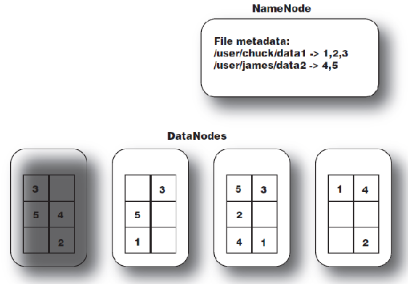
DataNode
Each slave machine in your cluster will host a DataNode daemon to perform the grunt work of the distributed filesystem
A DataNode may communicate with other DataNodes to replicate its data blocks for redundancy.
DataNodes are constantly reporting to the NameNode

Slide 39
To simplify the system implementation, the consistency model should be relaxed without placing an additional burden on the application developers.
As a result of this analysis several design decisions were made:
1.Segment a file in large chunks.
2. Implement an atomic file append operation allowing multiple applications operating concurrently to append to the same file.
3. Build the cluster around a high-bandwidth rather than low-latency interconnection network. Separate the flow of control from the data flow; schedule the high-bandwidth data flow by pipelining the data transfer over TCP connections to reduce the response time. Exploit network topology by sending data to the closest node in the network.

Slide 40
4.Eliminate caching at the client site; caching increases the overhead for maintaining consistency among cashed copies at multiple client sites and it is not likely to improve performance.
5. Ensure consistency by channeling critical file operations through a master controlling the entire system.
6. Minimize master’s involvement in file access operations to avoid hot-spot contention and to ensure scalability.
7. Support efficient checkpointing and fast recovery mechanisms.
8. Support efficient garbage collection mechanisms.
GFS files are collections of fixed-size segments called chunks; at the time of file creation each chunk is assigned a unique chunk handle.
A chunk consists of 64 KB blocks and each block has a 32 bit checksum.

Slide 41
Chunks are stored on Linux files systems and are replicated on multiple sites; a user may change the number of the replicas, from the standard value of three, to any desired value.
A large chunk size increases the likelihood that multiple operations will be directed to the same chunk thus, it reduces the number of requests to locate the chunk and, at the same time, it allows an application to maintain a persistent network connection with the server where the chunk is located.
The master controls a large number of chunk servers and maintains metadata such as the file names, access control information, the location of all the replicas for every chunk of each file, and the state of individual chunk servers.
Some of the metadata is stored in persistent storage, e.g., the operation log records the file namespace, the file-to-chunk-mapping.
The locations of the chunks are stored only in the control structure of the master’s memory and are updated at the system start up, or when a new chunk server joins the cluster.
This strategy allows the master to have up-to-date information about the location of the chunks.

Slide 42
System reliability is a major concern and the operation log maintains a historical record of metadata changes enabling the master to recover in case of a failure.
As a result, such changes are atomic and are not made visible to the clients until they have been recorded on multiple replicas on persistent storage.

Slide 43
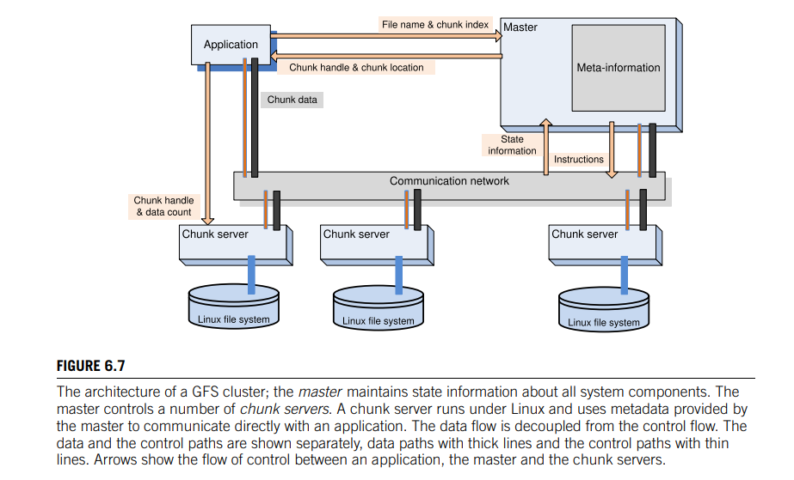

Slide 44
To recover from a failure, the master replays the operation log. To minimize the recovery time, the master periodically checkpoints its state and at recovery time it replays only the log records after the last checkpoint.
Each chunk server is a commodity Linux system. A chunk server receives instructions from the master and responds with status information. For file read or write operations an application sends to the master the file name, the chunk index, and the offset in the file.
The master responds with the chunkhandle and the location of the chunk. Then the application communicates directly with the chunk server to carry out the desired file operation.
To ensure scalability, the master has a minimal involvement in file mutations, operations such as write or append which occur frequently.
In such cases the master grants a lease for a particular chunk to one of the chunk servers called the primary; then, the primary creates a serial order for the updates of that chunk.

Slide 45
The following steps of a write request illustrate the process which buffers data and decouples the control flow from the data flow for efficiency:
1. The client contacts the master which assigns a lease to one of the chunk servers for the particular chunk, if no lease for that chunk exists; then, the master replies with the Ids of the primary and the secondary chunk servers holding replicas of the chunk. The client caches this information.
2. The client sends the data to all chunk servers holding replicas of the chunk; each one of the chunk servers stores the data in an internal LRU buffer and then sends an acknowledgment to the client.
3. The client sends the write request to the primary chunk server once it has received the acknowledgments from all chunk servers holding replicas of the chunk. The primary chunk server identifies mutations by consecutive sequence numbers.
4. The primary chunk server sends the write requests to all secondaries.
5. Each secondary chunk server applies the mutations in the order of the sequence number and then sends an acknowledgment to the primary chunk server.
6. Finally, after receiving the acknowledgments from all secondaries, the primary informs the client.
.

Slide 46
The system supports an efficient checkpointing procedure based on copy-on-write to construct system snapshots.
A lazy garbage collection strategy is used to reclaim the space after a file deletion. As a first step, the file name is changed to a hidden name and this operation is time stamped.
The master periodically scans the namespace, removes the metadata for the files with a hidden name older than a few days.
This mechanism gives a window of opportunity to a user who deleted files by mistake to recover the files with little effort.
Periodically, chunk servers exchange with the master the list of chunks stored on each one of them; the master supplies them with the identity of orphaned chunks, whose metadata has been deleted and such chunks are then deleted.
Even when control messages are lost, a chunk server will carry out the house cleaning at the next heartbeat exchange with the master.
Each chunk server maintains in core the checksums for the locally stored chunks to guarantee data integrity

Slide 47
Apache Hadoop
A wide range of data-intensive applications such as marketing analytics, image processing, machine learning, and Web crawling use Apache Hadoop, an open-source, Java-based software system.
Hadoop supports distributed applications handling extremely large volumes of data. Many members of the community contributed to the development and optimization of Hadoop and several related Apache projects such as Hive and HBase.
Hadoop is used by many organizations from industry, government, and research.
the long list of Hadoop users includes major IT companies such as Apple, IBM, HP, Microsoft, Yahoo!, and Amazon; media companies such as The New York Times and Fox; social networks, including Twitter, Facebook, and LinkedIn; and government agencies, such as the U.S.
Federal Reserve. In 2011, the Facebook Hadoop cluster had a capacity of 30 PB.

Slide 48
Hadoop system has two components, a MapReduce engine and a database (see Figure 8.8).
The database could be the Hadoop File System (HDFS), Amazon S3, or CloudStore, an implementation of the Google File System discussed in Section 8.5. HDFS is a distributed file system written in Java
It is portable, but it cannot be directly mounted on an existing operating system. HDFS is not fully POSIX compliant, but it is highly performant.

Slide 49
The Hadoop engine on the master of a multinode cluster consists of a job tracker and a task tracker, whereas the engine on a slave has only a task tracker. The job tracker receives a MapReduce job from a client and dispatches the work to the task trackers running on the nodes of a cluster.
To increase efficiency, the job tracker attempts to dispatch the tasks to available slaves closest to the place where it stored the task data.
The task tracker supervises the execution of the work allocated to the node.
Several scheduling algorithms have been implemented in Hadoop engines, including Facebook’s fair scheduler and Yahoo!’s capacity scheduler; see Section 6.8 for a discussion of cloud scheduling algorithms.

Slide 50
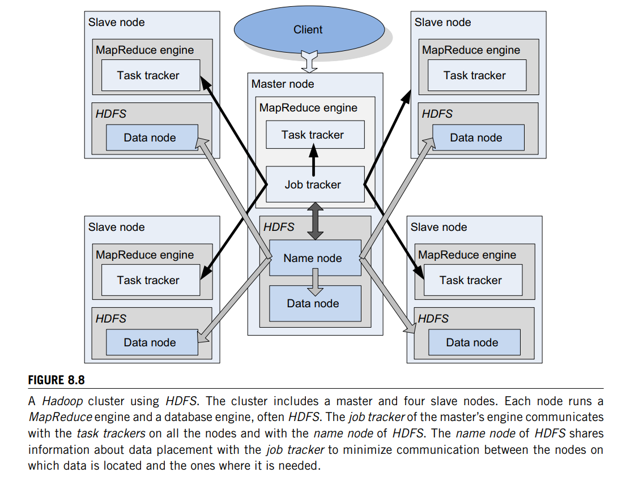

Slide 51
HDFS replicates data on multiple nodes. The default is three replicas; a large dataset is distributed over many nodes.
The name node running on the master manages the data distribution and data replication and communicates with data nodes running on all cluster node
it shares with the job tracker information about data placement to minimize communication between the nodes on which data is located and the ones where it is needed.
Although HDFS can be used for applications other than those based on the MapReduce model, its performance for such applications is not at par with the ones for which it was originally designed

Slide 52
Locks and Chubby: A locking service
Locks support the implementation of reliable storage for loosely coupled distributed systems; they enable controlled access to shared storage and ensure atomicity of read and write operations.
Furthermore, critically important to the design of reliable distributed storage systems are distributed consensus problems, such as the election of a master from a group of data servers.
A master has an important role in system management; for example, in GFS the master maintains state information about all system components

Slide 53
Locking and the election of a master can be done using a version of the Paxos algorithm for asynchronous consensus, discussed in Section 2.11.
The algorithm guarantees safety without any timing assumptions, a necessary condition in a large-scale system when communication delays are unpredictable.
Nevertheless, the algorithm must use clocks to ensure liveliness and to overcome the impossibility of reaching consensus with a single faulty process [123]. Coordination using the Paxos algorithm is discussed in Section 4.5

Slide 54
Advisory locks are based on the assumption that all processes play by the rules. Advisory locks do not have any effect on processes that circumvent the locking mechanisms and access the shared objects directly.
Mandatory locks block access to the locked objects to all processes that do not hold the locks, regardless of whether they use locking primitives.

Slide 55
A third design decision is how to support a systematic approach to locking.
Two alternatives come to mind:
(i) delegate to the clients the implementation of the consensus algorithm and provide a library of functions needed for this task, or (ii) create a locking service that implements a version of the asynchronous Paxos algorithm and provide a library to be linked with an application client to support service calls.
Forcing application developers to invoke calls to a Paxos library is more cumbersome and more prone to errors than the service alternative.
Of course, the lock service itself has to be scalable to support a potentially heavy load.

Slide 56
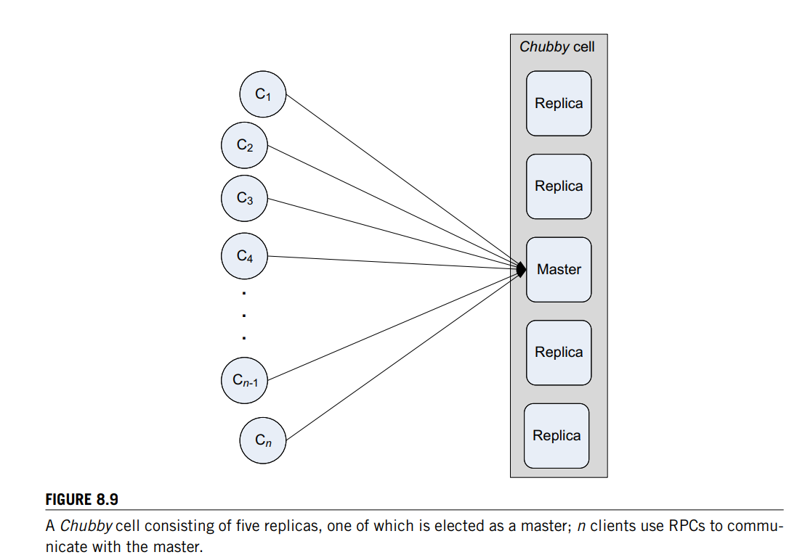
In the early 2000s, when Google started to develop a lock service called Chubby [61], it was decided to use advisory and coarse-grained locks.
The service is used by several Google systems, including the GFS discussed in Section 8.5 and BigTable

Slide 57
The basic organization of the system is shown in Figure 8.9. A Chubby cell typically serves one data center.
The cell server includes several replicas, the standard number of which is five. To reduce the probability of correlated failures, the servers hosting replicas are distributed across the campus of a data center.

Slide 58
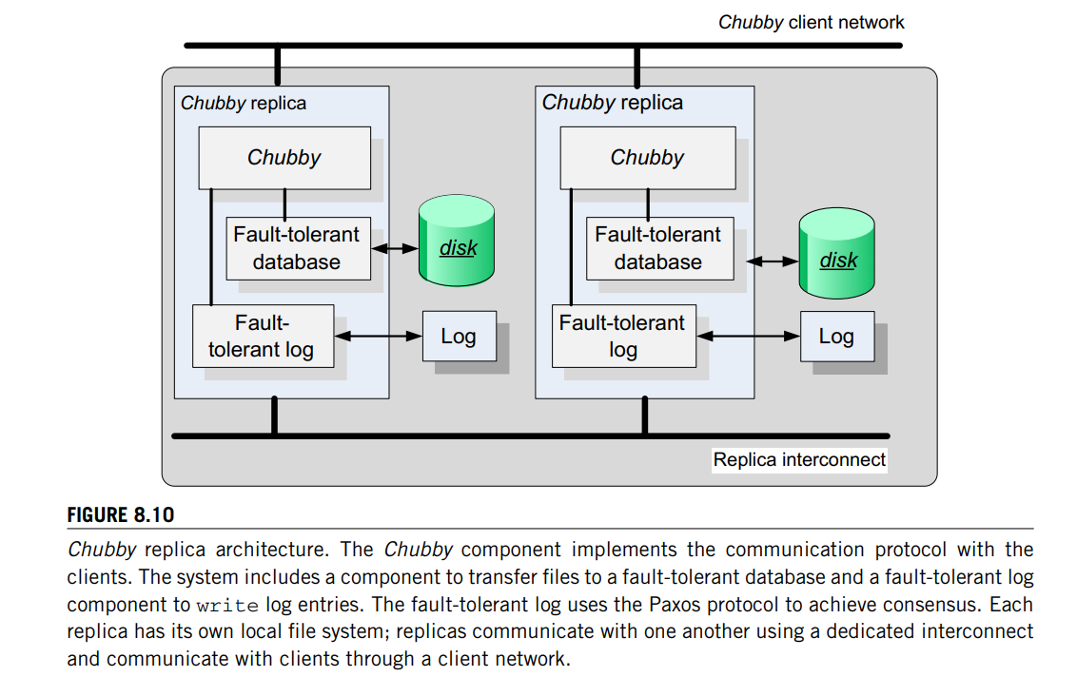

Slide 59
The Paxos algorithm is used to reach consensus on sets of values (e.g., the sequence of entries in a replicated log). To ensure that the Paxos algorithm succeeds in spite of the occasional failure of a replica, the following three phases of the algorithm are executed repeatedly
1. Elect a replica to be the master/coordinator. When a master fails, several replicas may decide to assume the role of a master. To ensure that the result of the election is unique, each replica generates a sequence number larger than any sequence number it has seen, in the range (1,r), where r is the number of replicas, and broadcasts it in a propose message. The replicas that have not seen a higher sequence number broadcast a promise reply and declare that they will reject proposals from other candidate masters. If the number of respondents represents a majority of replicas, the one that sent the propose message is elected master.

Slide 60
2. The master broadcasts to all replicas an accept message, including the value it has selected, and waits for replies, either acknowledge or reject.
3. Consensus is reached when the majority of the replicas send an acknowledge message; then the master broadcasts the commit message

Slide 61
Transaction processing and NoSQL databases
Many cloud services are based on online transaction processing (OLTP) and operate under tight latency constraints.
Moreover, these applications have to deal with extremely high data volumes and are expected to provide reliable services for very large communities of users.
It did not take very long for companies heavily involved in cloud computing, such as Google and Amazon, e-commerce companies such as eBay, and social media networks such as Facebook, Twitter, or LinkedIn, to discover that traditional relational databases are not able to handle the massive amount of data and the real-time demands of online applications that are critical for their business models

Slide 62
The search for alternate models with which to store the data on a cloud is motivated by the need to decrease the latency by caching frequently used data in memory on dedicated servers, rather than fetching it repeatedly.
In addition, distributing the data on a large number of servers allows multiple transactions to occur at the same time and decreases the response time.
The relational schema are of little use for such applications in which conversion to key-value databases seems a much better approach.
Of course, such systems do not store meaningful metadata information, unless they use extensions that cannot be exported easily.

Slide 63
A major concern for the designers of OLTP systems is to reduce the response time.
The term memcaching refers to a general-purpose distributed memory system that caches objects in main memory (RAM); the system is based on a very large hash table distributed across many servers.
The memcached system is based on a client-server architecture and runs under several operating systems, including Linux, Unix, Mac OS X, and Windows.
The servers maintain a key-value associative array.
The API allows the clients to add entries to the array and to query it.
A key can be up to 250 bytes long, and a value can be no larger than 1 MB.
The memcached system uses an LRU cache-replacement strategy

Slide 64
Scalability is the other major concern for cloud OLTP applications and implicitly for datastores.
There is a distinction between vertical scaling, where the data and the workload are distributed to systems that share resources such as cores and processors, disks, and possibly RAM, and horizontal scaling, where the systems do not share either primary or secondary storage [66].

Slide 65
Cloud stores such as document stores and NoSQL databases are designed to scale well, do not exhibit a single point of failure, have built-in support for consensus-based decisions, and support partitioning and replication as basic primitives.
Systems such as Amazon’s SimpleDB, discussed in Section 3.1; CouchDB (see http://couchdb.apache.org/), or Oracle NoSQL database [277] are very popular, though they provide less functionality than traditional databases.
The key-value data model is very popular.
Several such systems, including Voldemort, Redis, Scalaris, and Tokyo cabinet, are discussed in [66].

Slide 66
The “soft-state” approach in the design of NoSQL allows data to be inconsistent and transfers the task of implementing only the subset of the ACID properties required by a specific application to the application developer.
The NoSQL systems ensure that data will be “eventually consistent” at some future point in time instead of enforcing consistency at the time when a transaction is “committed.”
Data partitioning among multiple storage servers and data replication are also tenets of the NoSQL

Slide 67
The overhead of OLTP systems is due to four sources with equal contribution: logging, locking, latching, and buffer management.
Logging is expensive because traditional databases require transaction durability; thus, every write to the database can be completed only after the log has been updated.
To guarantee atomicity, transactions lock every record, and this requires access to a lock table.
Many operations require multithreading, and the access to shared data structures, such as lock tables, demands short-term latches8 for coordination.
The breakdown of the instruction count for these operations in existing DBMSs is as follows: 34.6% for buffer management, 14.2% for latching, 16.3% for locking, 11.9% for logging, and 16.2% for hand-coded optimization

Slide 68
BigTable
BigTable is a distributed storage system developed by Google to store massive amounts of data and to scale up to thousands of storage servers [73].
The system uses the Google File System discussed in Section 8.5 to store user data as well as system information.
To guarantee atomic read and write operations, it uses the Chubby distributed lock service (see Section 8.7); the directories and the files in the namespace of Chubby are used as locks.

Slide 69
The system is based on a simple and flexible data model. It allows an application developer to exercise control over the data format and layout and reveals data locality information to the application clients.
Any read or write row operation is atomic, even when it affects more than one column.
The column keys identify column families, which are units of access control.
The data in a column family is of the same type. Client applications written in C++ can add or delete values, search for a subset of data, and look up data in a row

Slide 70
A row key is an arbitrary string of up to 64 KB, and a row range is partitioned into tablets serving as units for load balancing.
The time stamps used to index various versions of the data in a cell are 64-bit integers; their interpretation can be defined by the application, whereas the default is the time of an event in microseconds.
A column key consists of a string defining the family name, a set of printable characters, and an arbitrary string as qualifier.

Slide 71
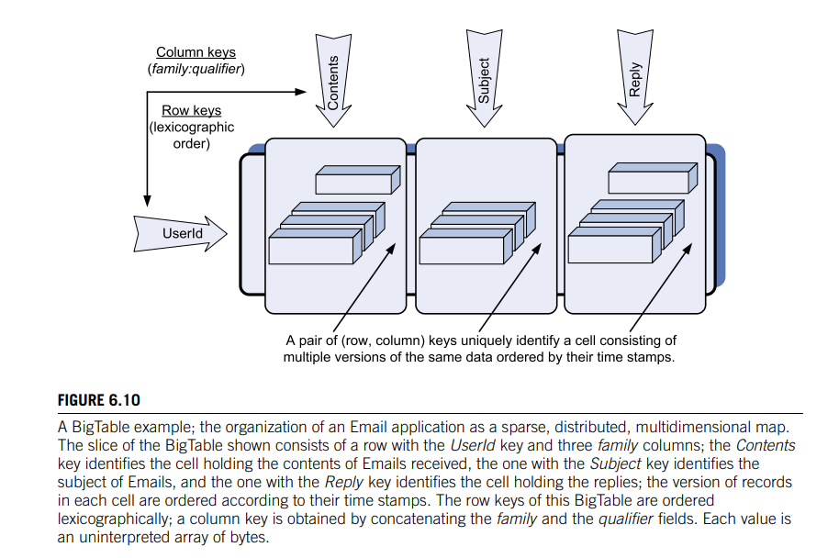

Slide 72
Internally, the space management is ensured by a three-level hierarchy:
the root tablet, the location of which is stored in a Chubby file, points to entries in the second element, the metadata tablet,
which, in turn, points to user tablets, collections of locations of users’ tablets.
An application client searches through this hierarchy to identify the location of its tablets and then caches the addresses for further use

Slide 73
The performance of the system reported in [73] is summarized in Table 8.2.
The table shows the number of random and sequential read and write and scan operations for 1, 000 bytes, when the number of servers increases from 1 to 50, then to 250, and finally to 500.
Locking prevents the system from achieving a linear speed-up, but the performance of the system is still remarkable due to a fair number of optimizations.
For example, the number of scans on 500 tablet servers is 7,843/2 × 103 instead of 15,385/2 × 103. It is reported that only 12 clusters use more than 500 tablet servers, whereas some 259 clusters use between 1 and 19 tablet servers

Slide 75
MEGASTORE
Scalable storage for online services.
Distributed over several data centers,
Has a very large capacity and is highly available.
Megastore is widely used internally at Google.
In 2011 Megastore had a capacity of 1PB, handled some 23 billion transactions daily, 3 billion write, and 20 billion read transactions.
The basic design of the system is to partition the data into entity groups and replicate each partition independently in data centers located in different geographic areas.
The system supports ACID semantics within each partition and provides consistency guarantees across partitions.
Megastore supports those database features that allow the system to scale well and do not affect the response time.
Another distinctive feature of the system is the use of the Paxos consensus algorithm for replicating primary user data, metadata, and system configuration information across data centers and for locking.
Megastore does not require a single master; instead, any node can initiate read and write operations to a write-ahead log replicated to a group of symmetric peers.
The entity groups are application-specific and store together logically related data.
for example, an email account could be an entity group for an Email application.
Data should be carefully partitioned to avoid excessive communication between entity groups.

Slide 76
The data model is declared in a schema consisting of a set of tables composed of entries. Each entry is a collection of named and typed properties. T
The unique primary key of an entity in a table is a composition of entry properties.
A Megastore table can be a root or a child table. Each child entity must reference a special entity, called root entity in its root table.
An entity group consists of a primary entity and all the entities that reference it.
The system makes use of BigTable. Entities from different Megastore tables can be mapped to the same BigTable row without collisions. This is possible because the BigTable column name is a concatenation of the Megastore table name and the name of a property.
A BigTable row for the root entity stores the transaction and all metadata for the entity group. Multiple versions of the data with different time stamps can be stored in a cell.
Megastore takes advantage of this feature to implement multi-version concurrency control. When a mutation of a transaction occurs, this mutation is recorded along with its time stamp and obsolete the old data.
Advantages: read and write operations can proceed concurrently, a read always returns the last fully updated version.
A write transaction involves several steps: (1) get the time stamp and the log position of the last committed transaction; (2) gather the write operations in a log entry; (3) use the consensus algorithm to append the log entry and then commit; (4) update the BigTable entries; and (5) cleanup

Slide 77
